Slide 1
by

Slide 2
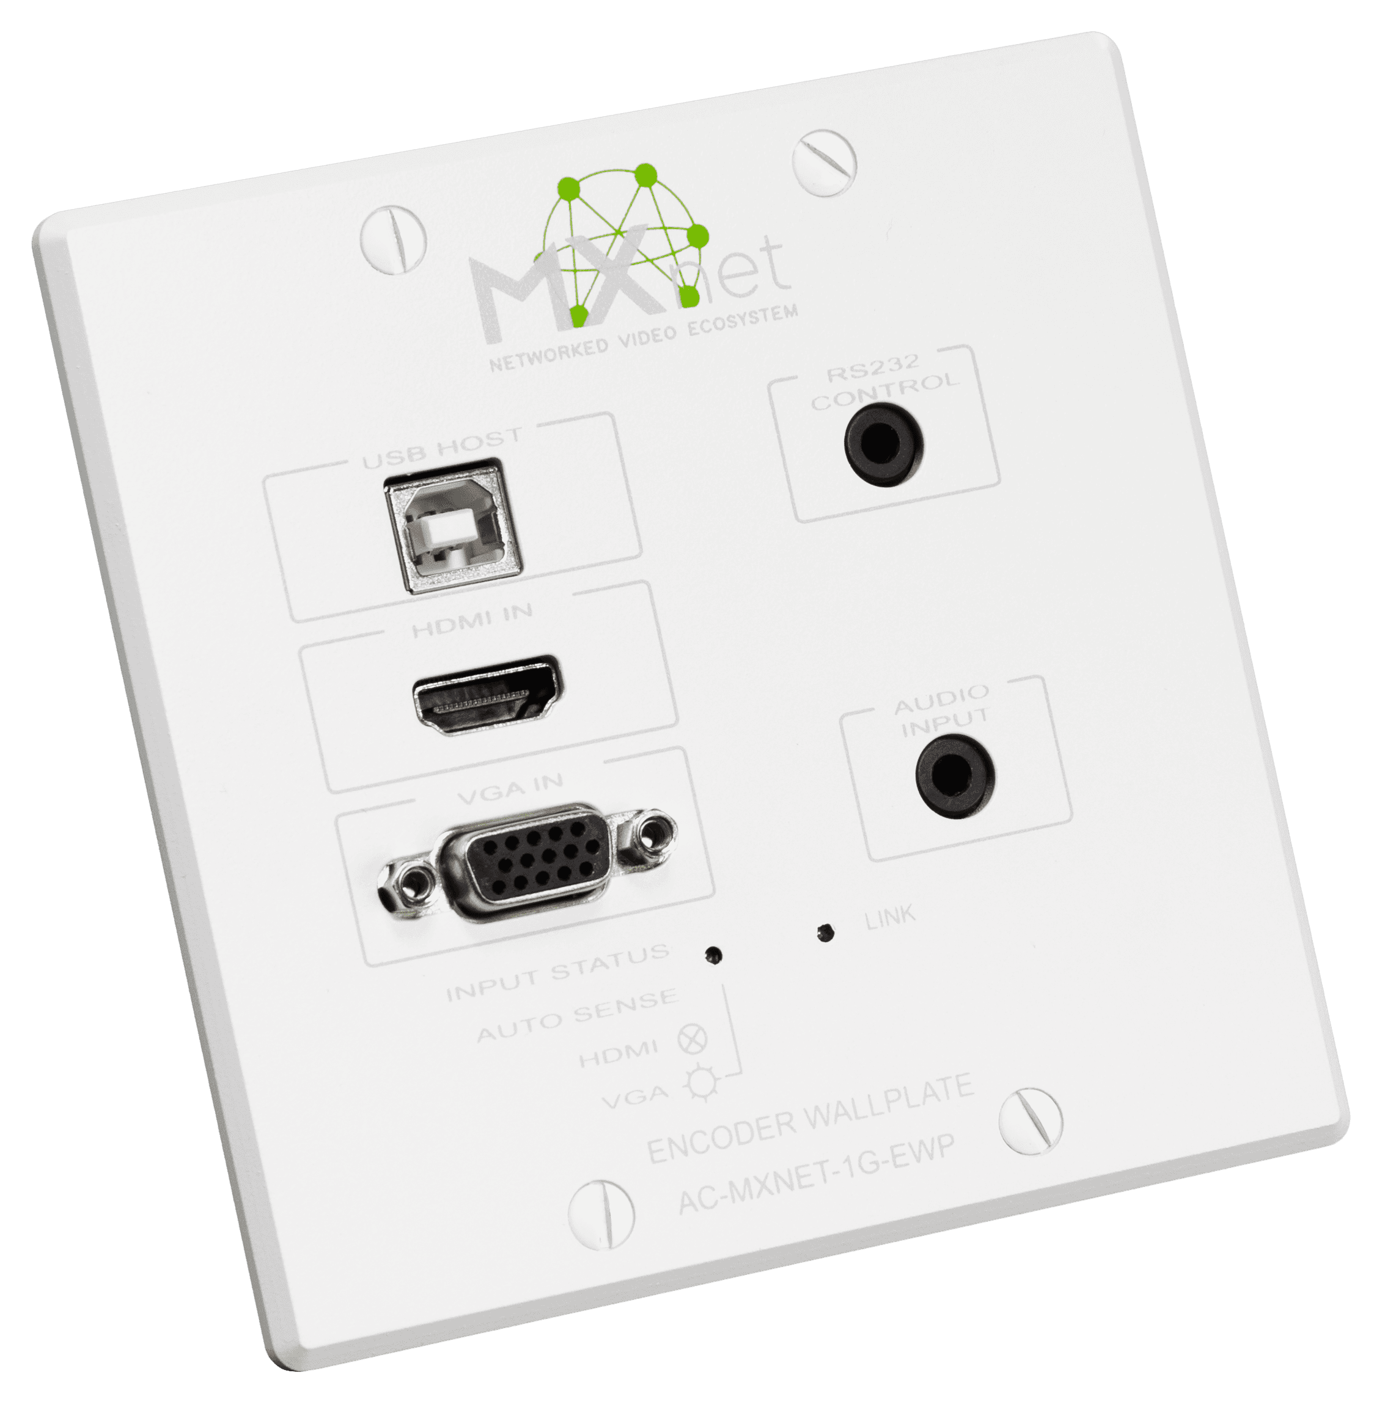
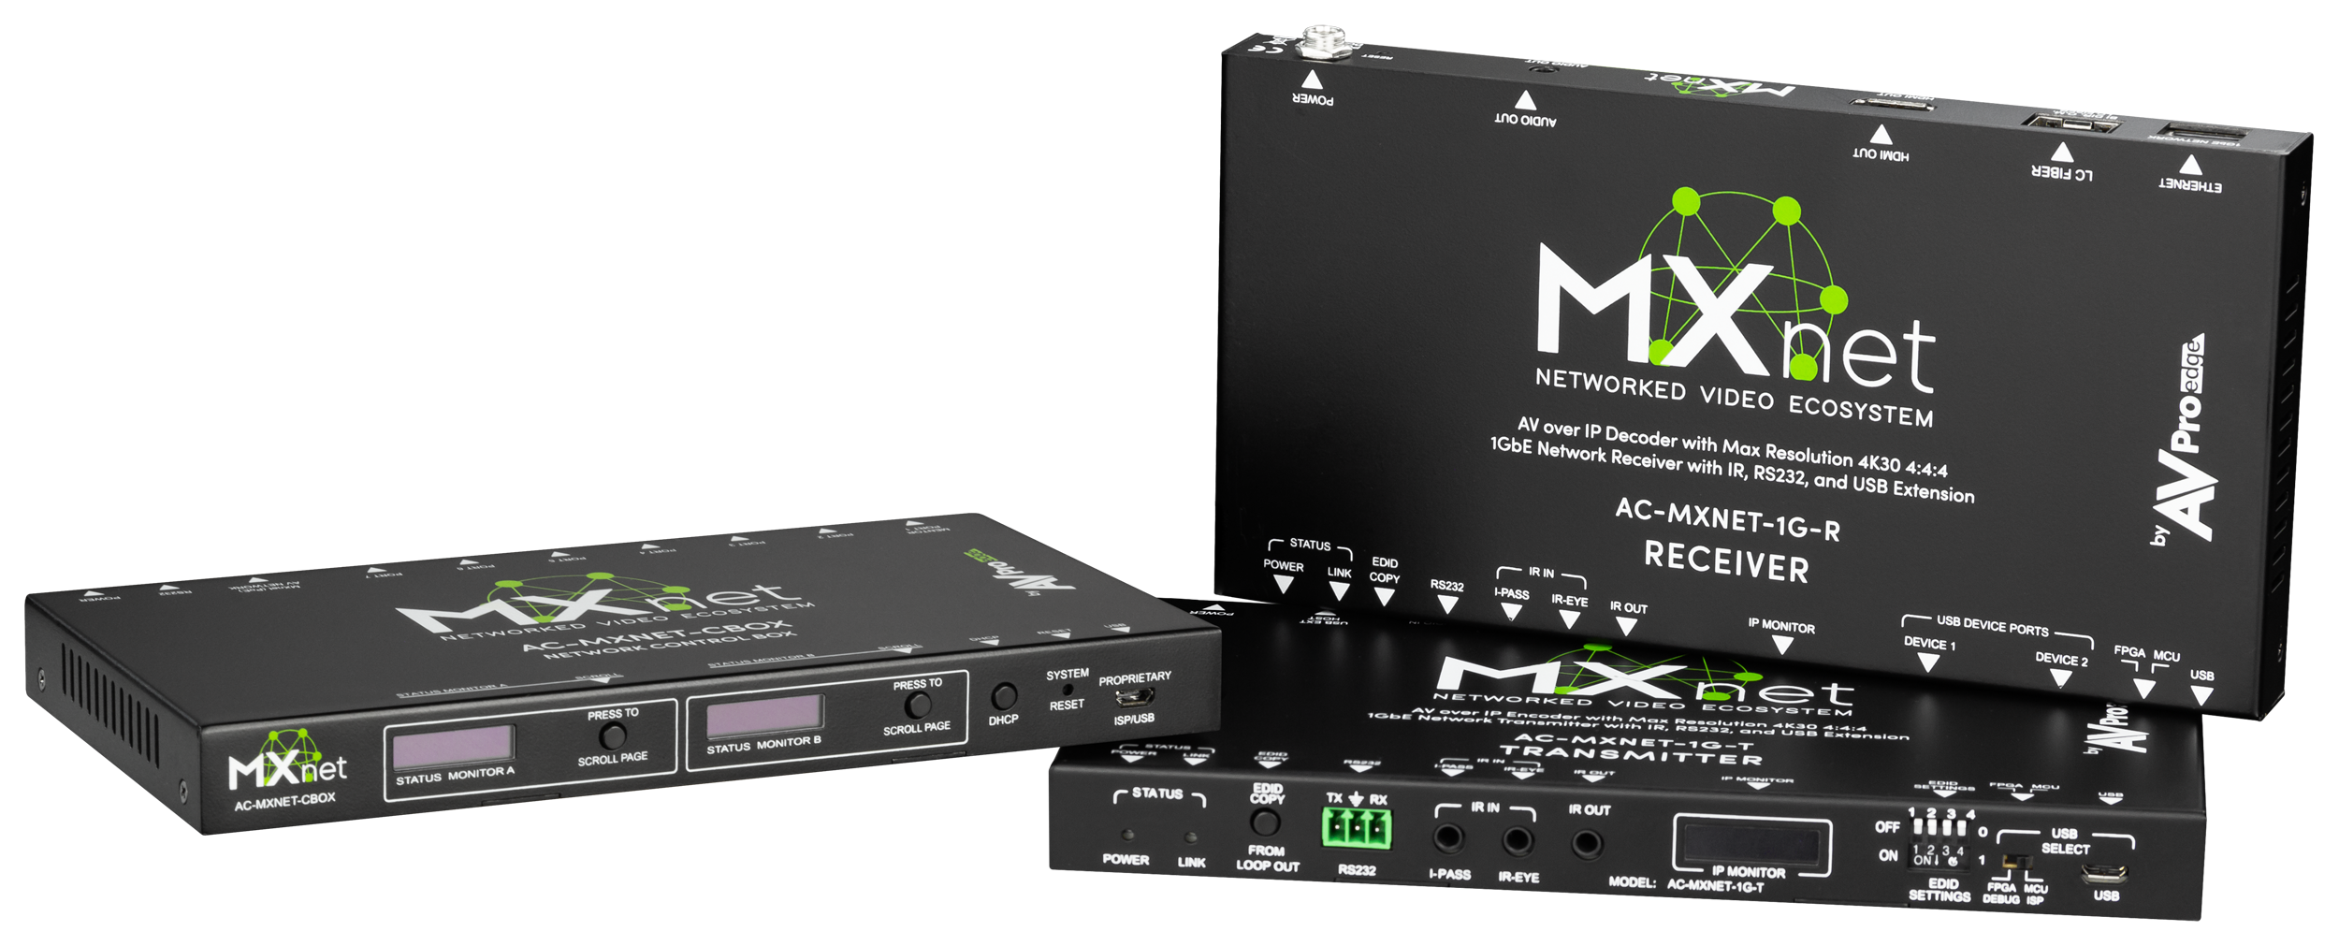
What is the MXNet Ecosystem?
The MXNet (Networked Technology Ecosystem) is a Networked AV line of products from AVPro Edge. This technology uses a traditional networking infrastructure to route Audio Video & USB signals throughout large scale systems that have limitless sources and displays. Inside the system you can route or repeat the sources to any of the connected displays. This entire Ecosystem is able to be controlled through any control system.
MXNet Ecosystem Components:
Network Switches
Encoder
Decoder
Controller
SFP adapters 10G and 1G

Slide 3
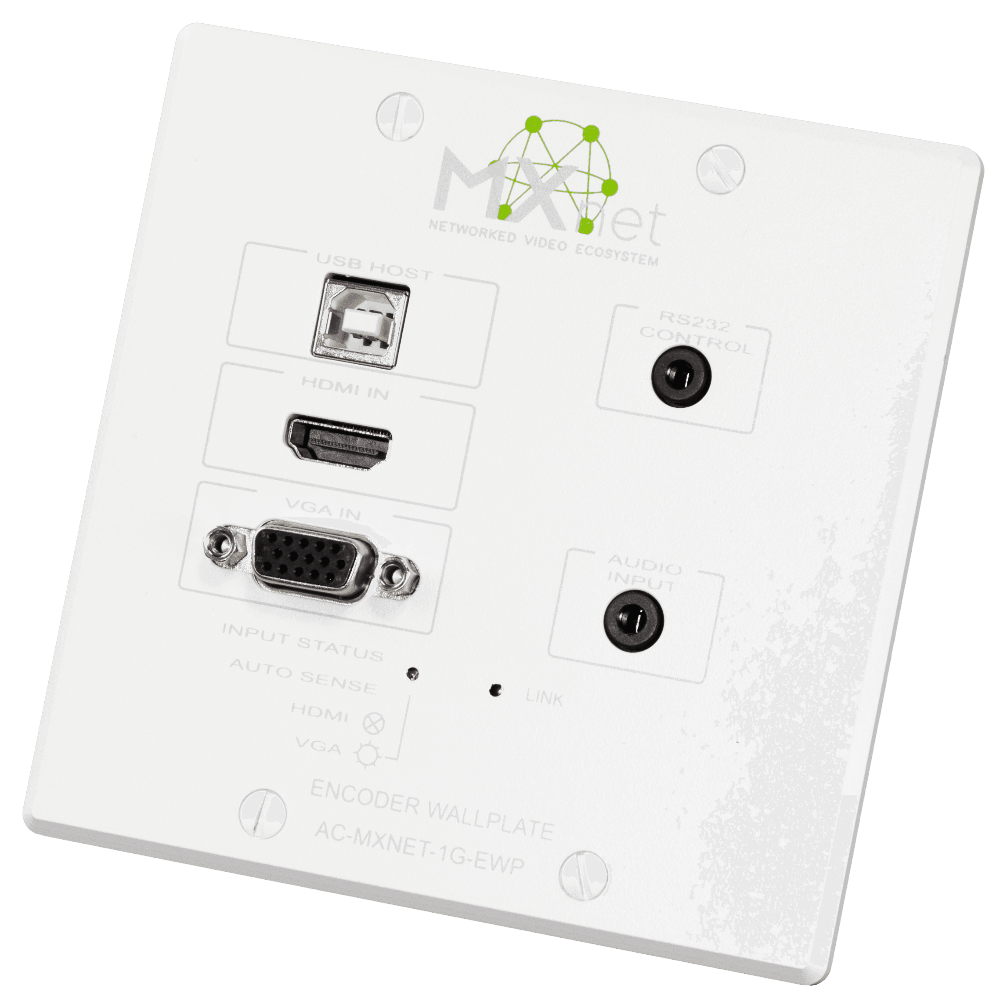
Wall Plate Encoder
Sleek looking, Wall mounted encoding device that will take in any HDMI signal, send it to the switch to be routed throughout the entire system.
Front Ports:
USB Host
HDMI Input
VGA Input with Audio
RS-232 Control
Back Ports:
RJ-45 for link to network switch

Slide 4
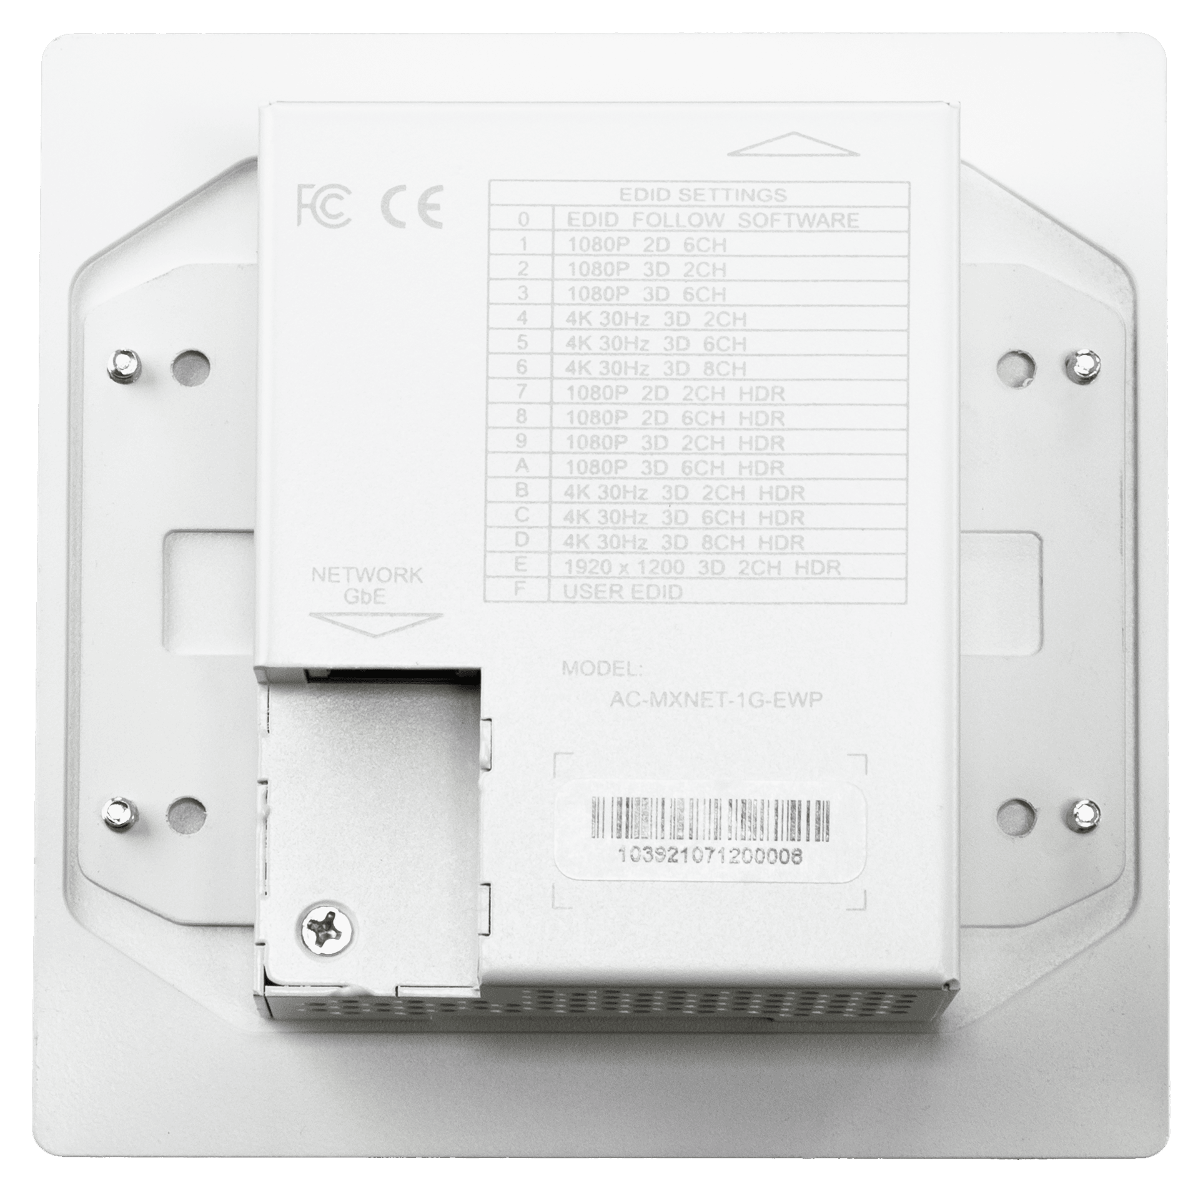
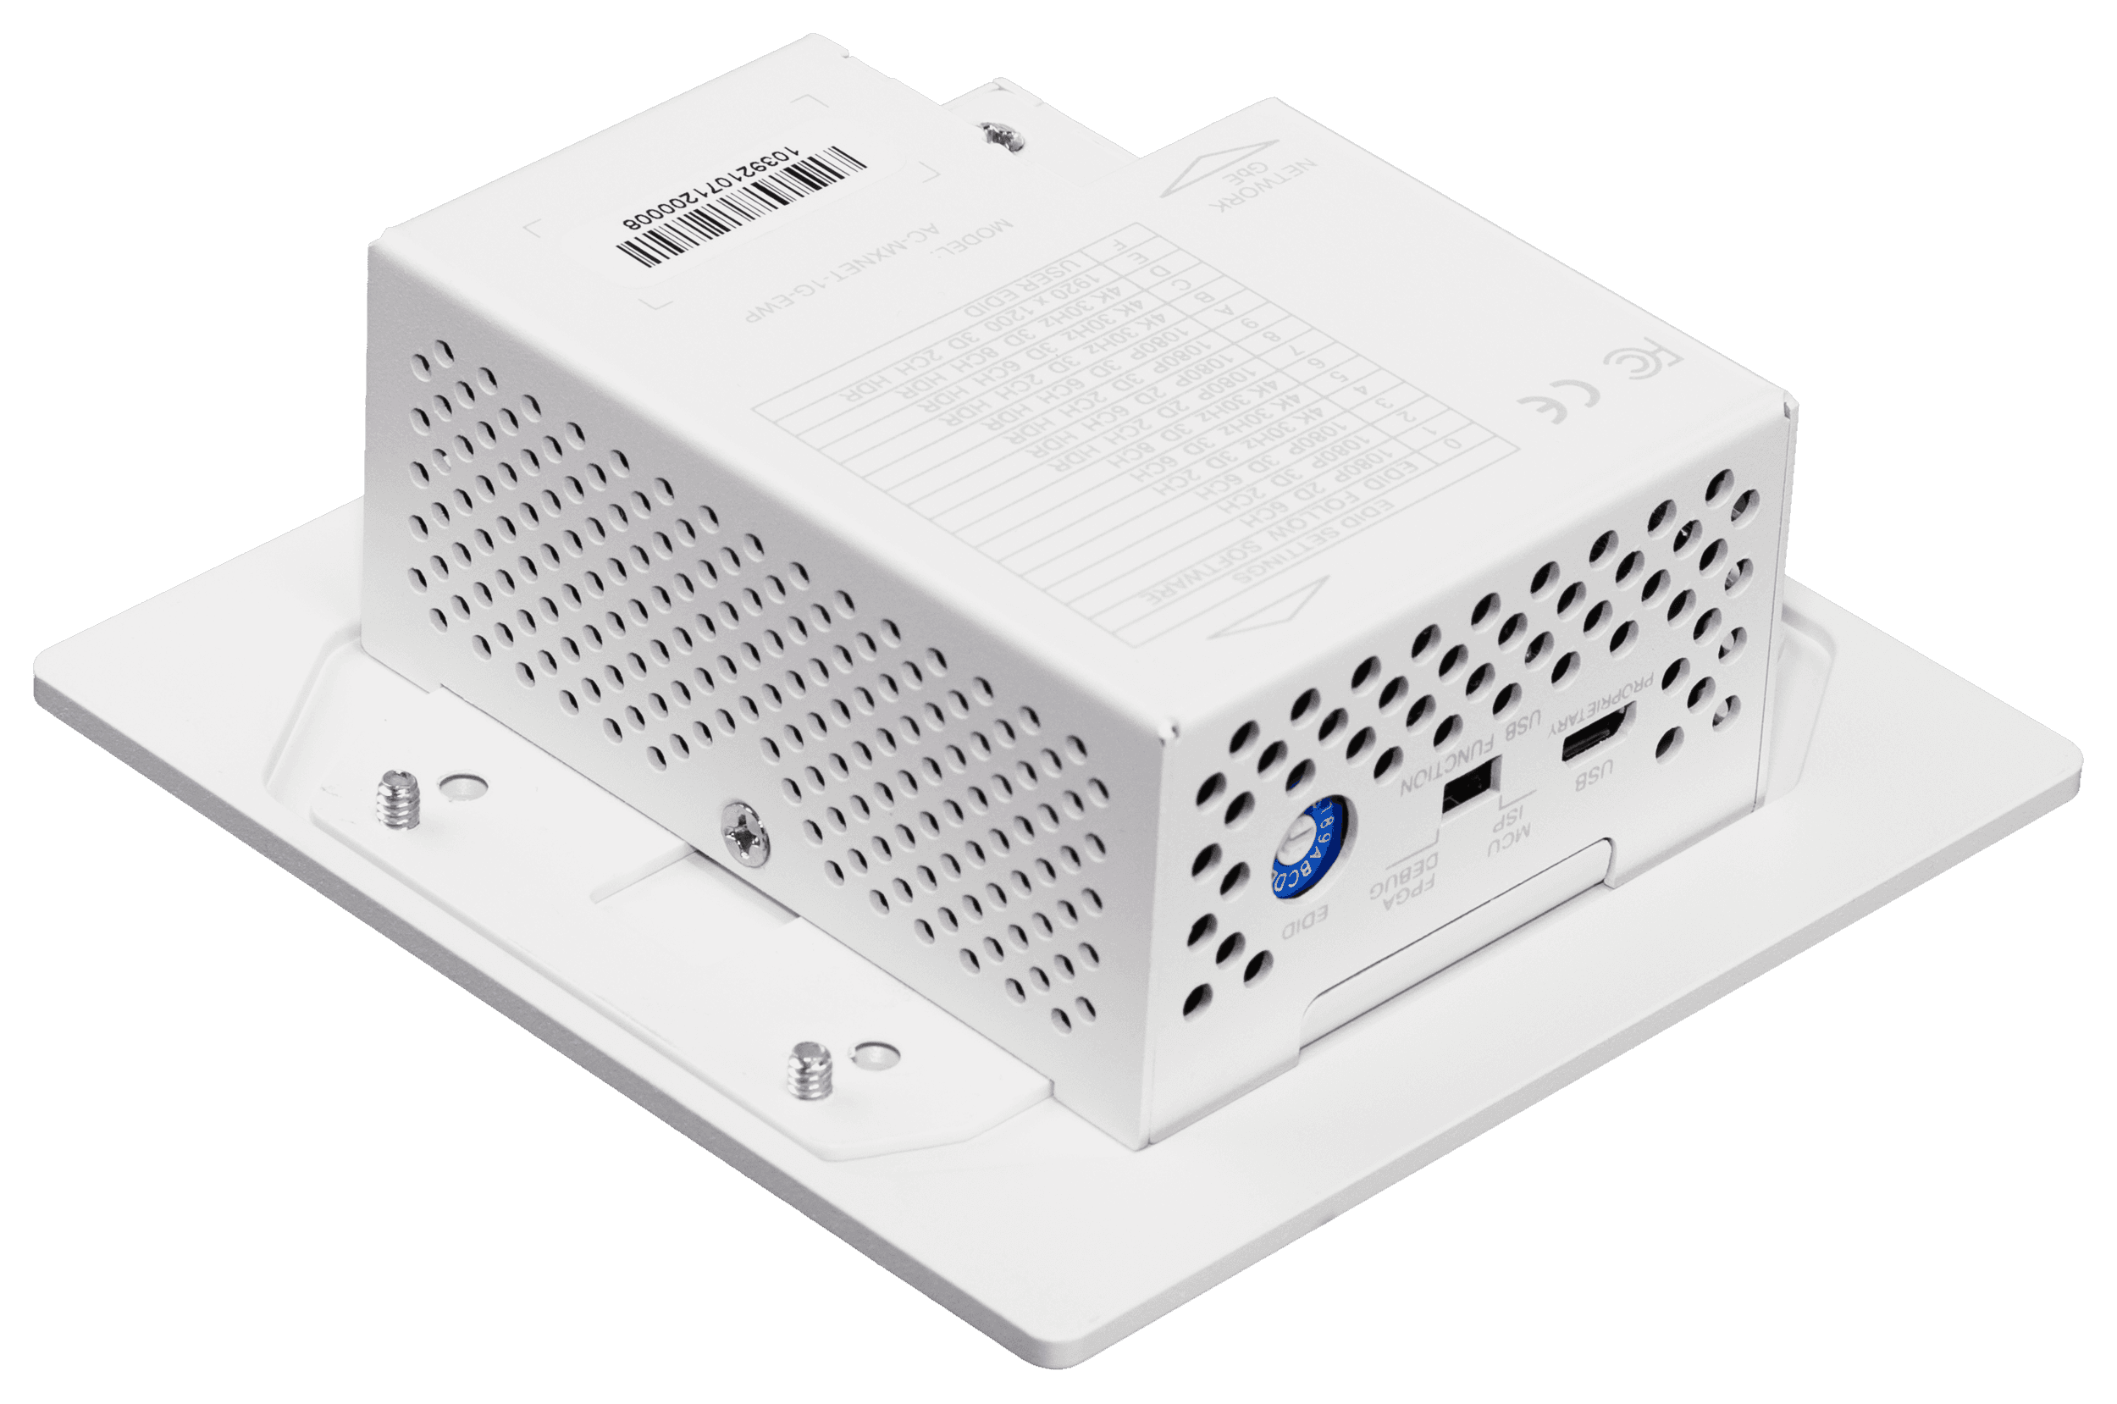
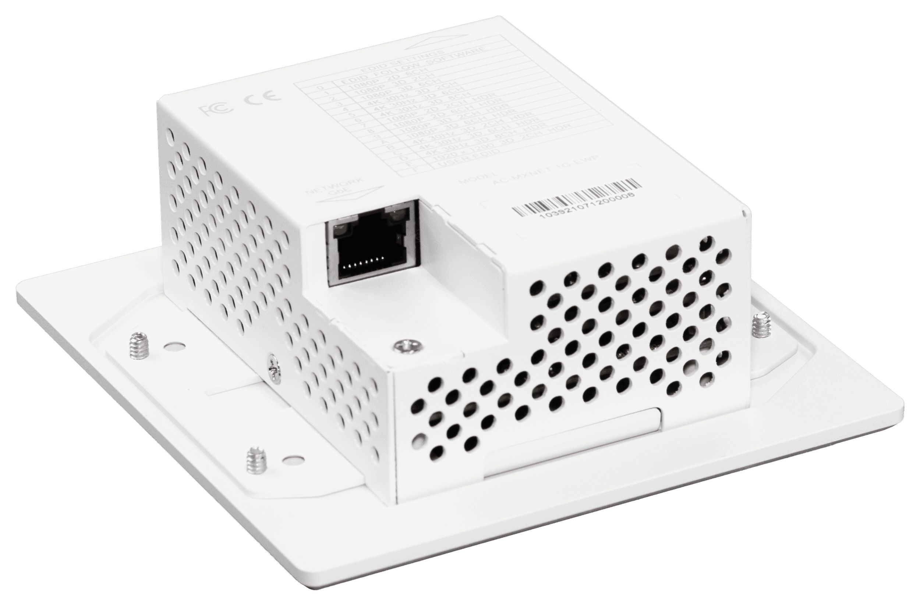

Slide 5
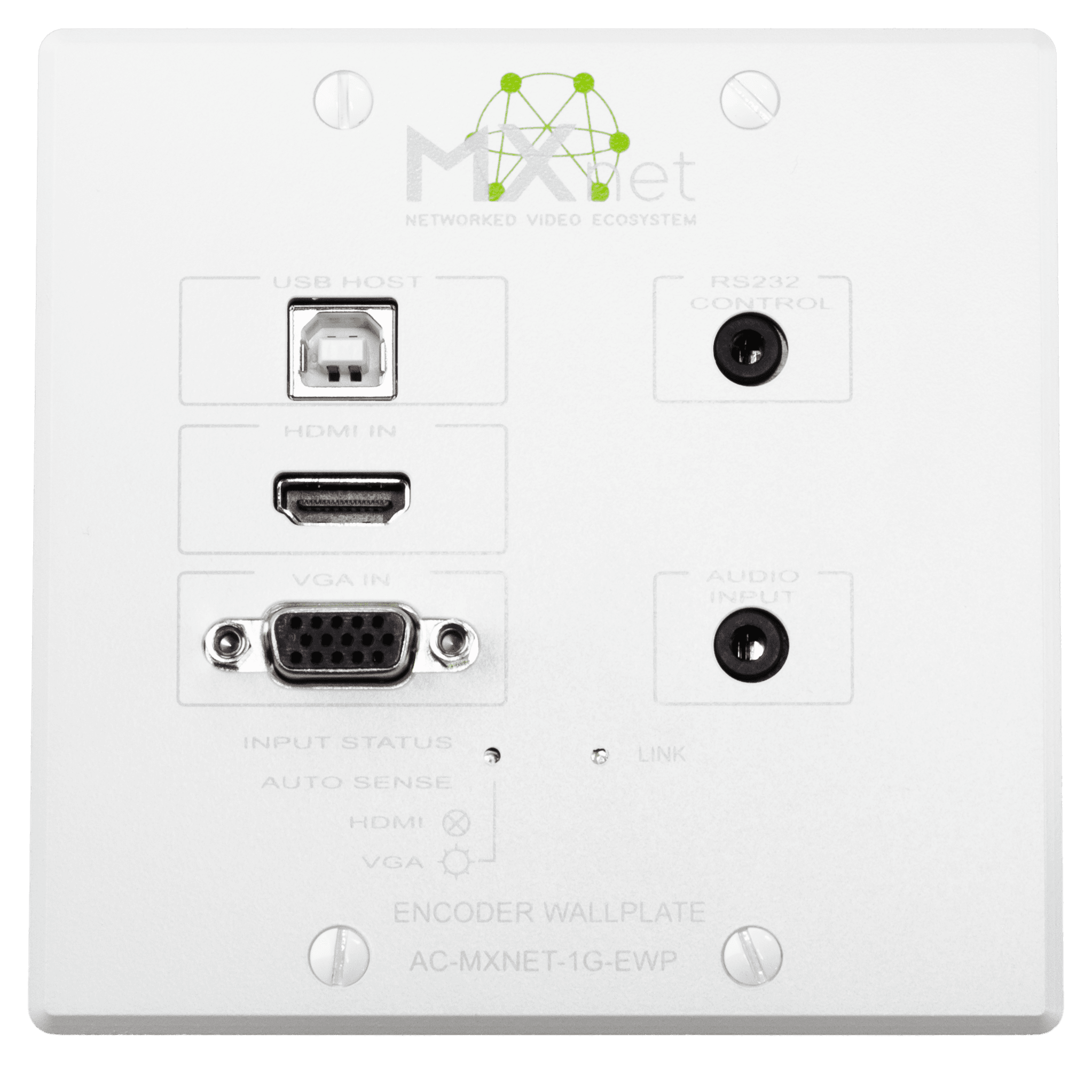

Slide 7
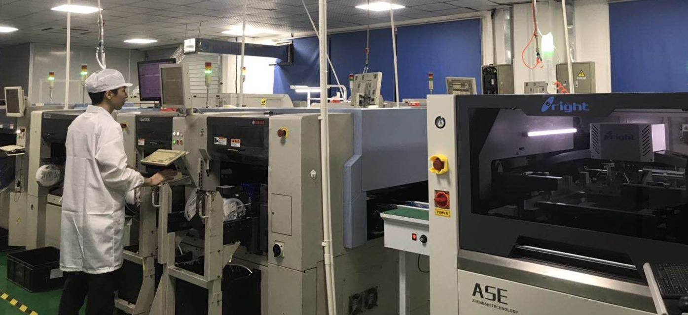
MXNet, Why we are Different
All system Components Designed Engineered and Manufactured by Us
Our #1 goal is Ease of Deployment with a long-term stable solution
Fast Switching
Enable scaling for the fastest switching!
USB for Smart Boards and Interactive Displays
USB 2.0 support with MXNet
Unlimited Video Walls
Configure and execute an unlimited amount of videowalls
Extensive Video Format Support
From 720p to 4K60 (4:4:4), with Interlaced to
progressive conversion
10-Year Warranty
Install with confidence
by

Slide 8
Optimization Tools
Scaling
You choose the resolution
Format Conversion
Interlaced to Progressive
Configuration of Unlimited Video Walls
MXNet is built to work with unlimited number of video wall
AVPro Switch
We built a Network Switch for AV that requires zero configuration, with plenty of horsepower for POE and works with industry standard products
Low Power Consumption (NO FANS)
A low power signal is easier on the ecosystem components, ensuring long lasting stable installations
Bi-Directional IR and RS-232
Unlimited repeating and routing
Output Color Space Configuration
YUV or RGB you choose
HDR Metadata Control
Ability to force it on, turn it off, or leave it native
Bandwidth Management
Allows you to vary the bandwidth based on format requirement, allows you to manage your bandwidth
3rd Party Switch and Control System Support
You can use Cisco, Luxul, Netgear Network switches and Control systems like Crestron, Q-SYS, ect

Slide 9
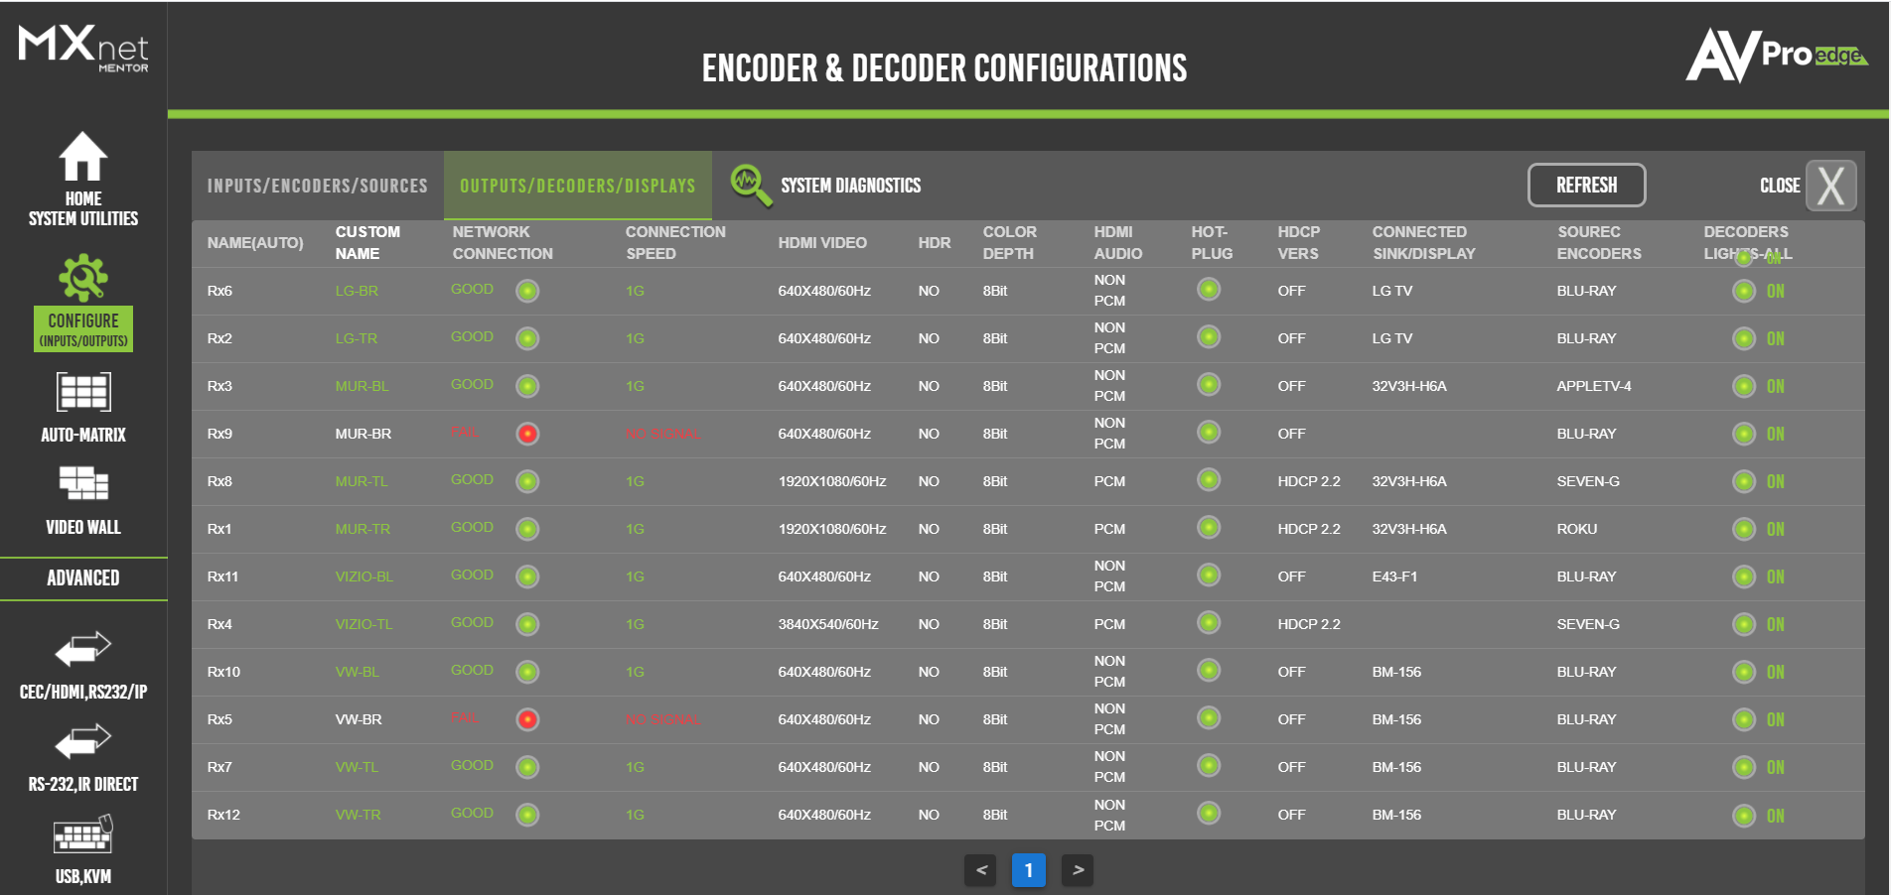
Integrators Diagnostics/Troubleshooting Tools
Hot Plug Event Control
Stop manually unplugging and plugging in HDMI cables when you want a Hot Plug Event
OTA Remote Firmware Updates
Save’s time, travel and headache managing firmware remotely
Data Window
Quick Visual access to IP address, Alias and MAC address
HDMI Signal Diagnostics
View characteristics of incoming/outgoing signals
Network Strength Diagnostics
View characteristics of network health
EDID management
You choose the signal format
Remote Monitoring
Works with 3rd Party Control Systems
by

Slide 11
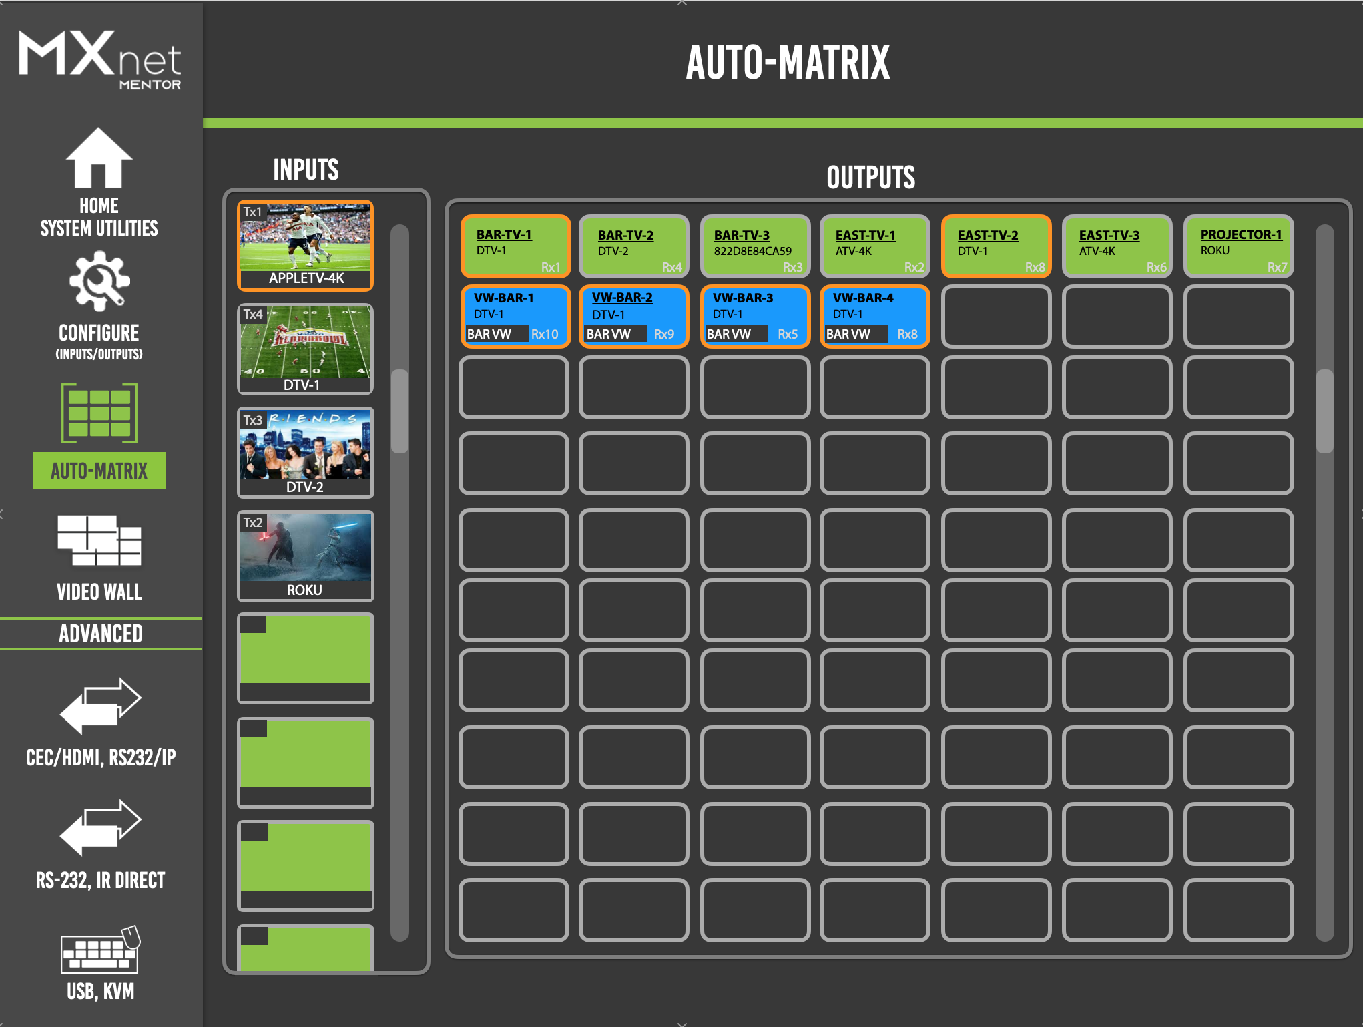

Slide 12
Benefits to Your Customer
Industry Leading Source Switching
Fast switching, any source to any displays, unlimited source repeating
Video Walls
Unlimited amount of video walls, up to 64 panel support, easy to set up and use, 90 &180 rotation
Distance Runs
SFP’s allow for long runs that can go miles and miles
10 Year Warranty
Peace of Mind knowing we have your back if something happens
Expandable
Add limitless sources or TV’s easily
Control System Compatibility
Crestron, Q-SYS , and more
Extremely Quiet and Low Heat
No fans equal zero DB’s! We engineered this system to remain cool
Serviceability
Built in monitoring and diagnosis and the ability to HOT SWAP components
A System that Works
Peace of mind that you are always going to get a picture when you connect a device

Slide 13
Questions?
We can’t wait to work together to bring the very best in Audio/Video Distribution to your clients.

